Slide 1

Building Intelligent Applications with LangChain and LLMs
Tfug Ml MUMBAI meetup – July edition

Slide 2
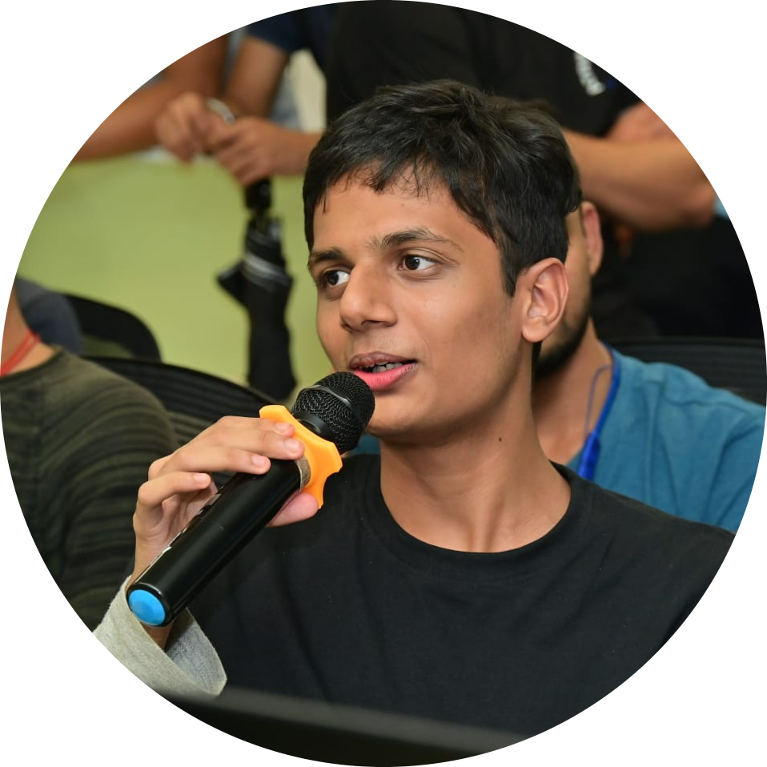
About Myself
Research Assistant IIT Patna, Mandi, Jodhpur, Dhanbad, DRDO and KCL London
Research Head @DJSACM
Researcher in Natural Language Processing and AI
Full Stack Developer
5x Professional Speaker now 6x :)
Final Year Student at DJ Sanghvi College of Engineering

Slide 3
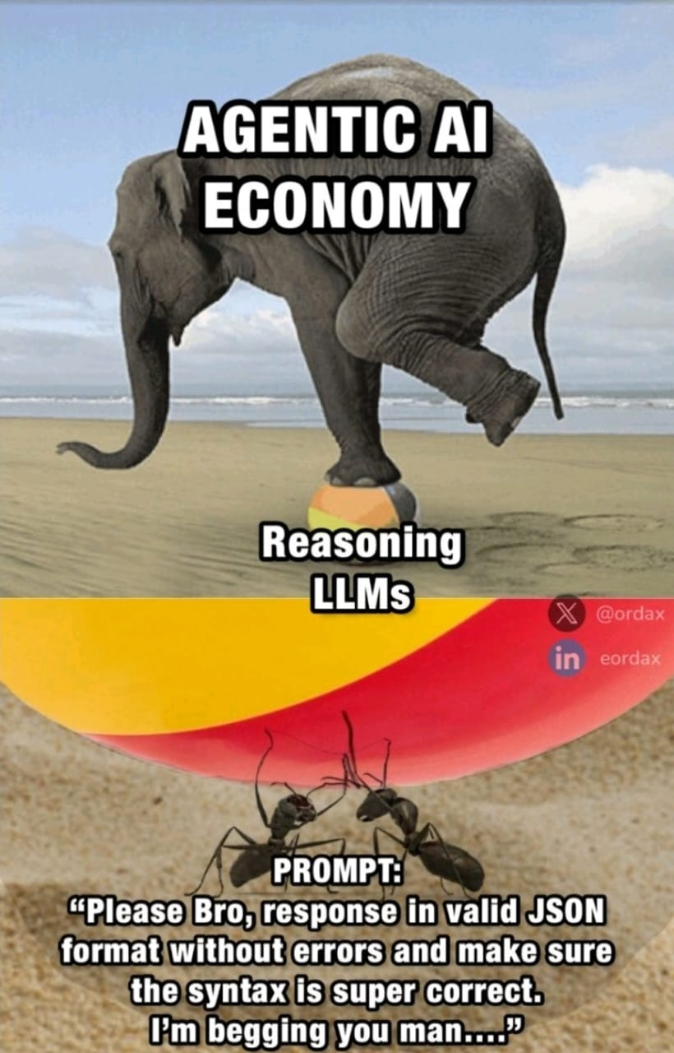
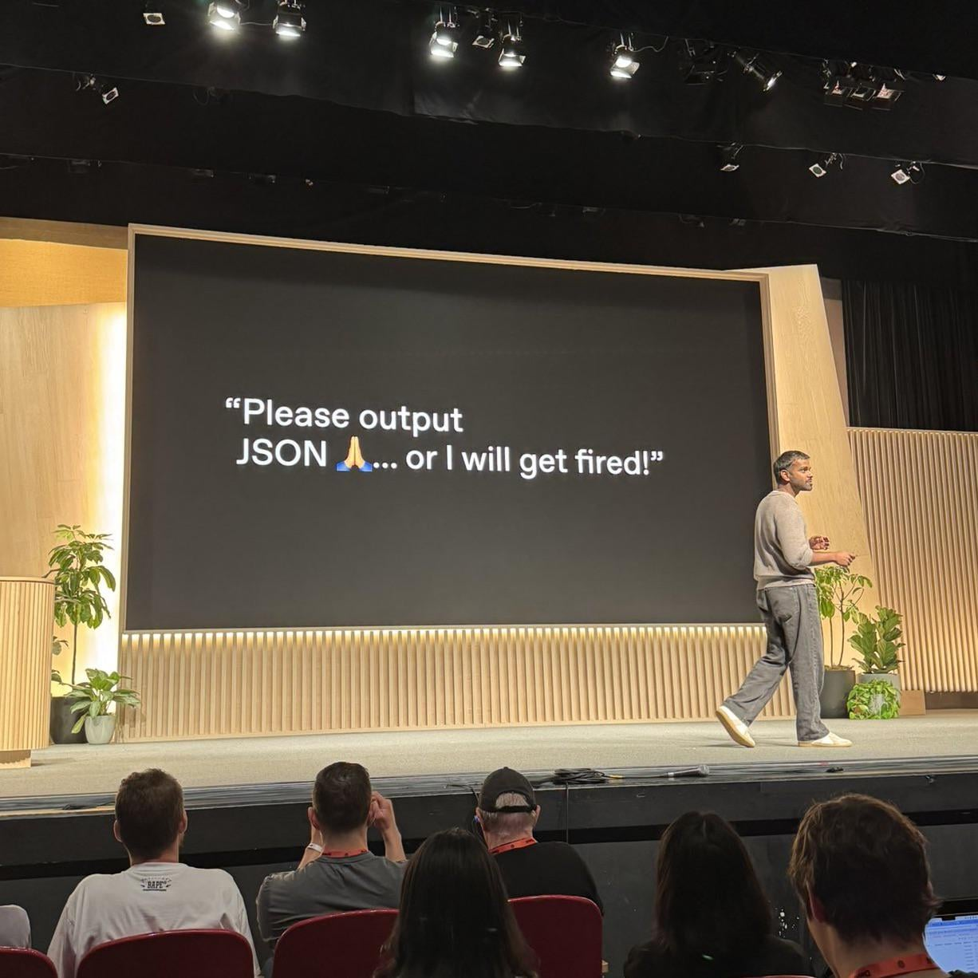
Why am I giving this talk?

Slide 4

LangChain
A Python framework to build applications powered by LLMs
Helps manage prompts, memory, chains, tools, and agents
Ideal for chatbots, document Q&A, agents, and more
Abstracts complexity of calling LLMs repeatedly
Easy chaining of tasks and reasoning steps
Built-in support for structured outputs (e.g., Pydantic, JSON)

Slide 5
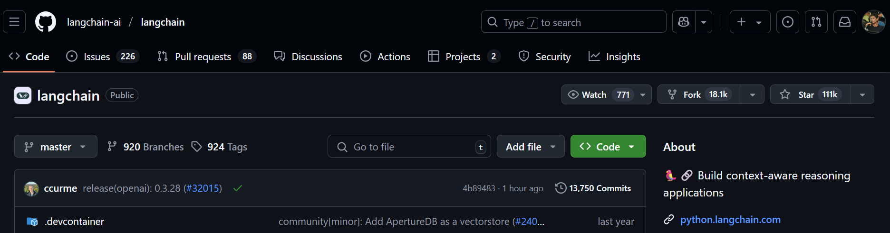
Why LangChain?
pip install langchain
npm install langchain
Popular Alternatives : LlamaIndex, Haystack

Slide 6

Tutorial
https://github.com/MihirRajeshPanchal/ml-mumbai
bit.ly/tfugmumbai

Slide 7


Connect me on
LinkTree
Portfolio

